Slide 1
Gary Paulsen
Author for 1st grade or higher

Slide 2
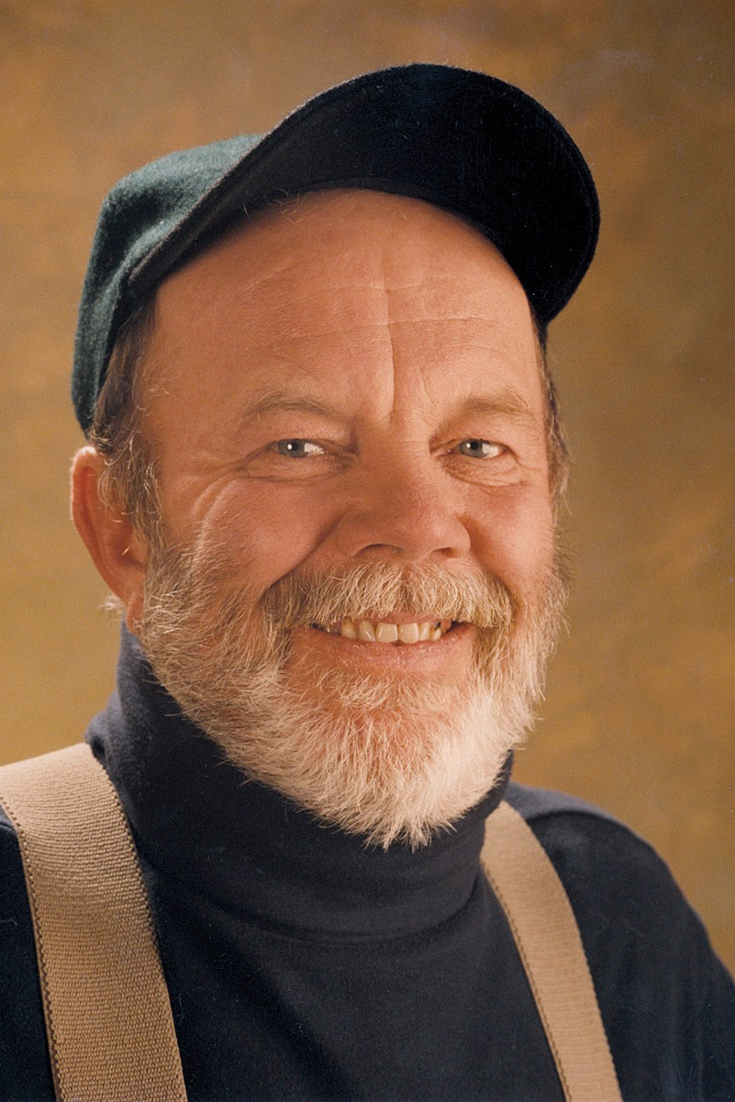
Career
Gary Paulsen has had a wild life, he ran away from home at age 14 to join a carnival! He is now 75 years old and has written over 200 books! Could you imagine? He was able to write the books he had mostly from personal experience because he lived in the outdoors without his parents and learned to live in the wild. Paulsen was also able to participate the Iditarod dog races! Wouldn’t that be something to write about? He is very talented and lived a full life.

Slide 3


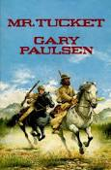
Favorite books
Brian’s Winter
Hatchet
Mr. Tucket

Slide 4
Quotations
Gary Paulsen was and is an amazing writer, I hope some of you have an interest in his writing or have read some of his books. They mostly apply to a young boys life but will entertain all of you as young readers. What he has to say can mean a lot. Quotations are sentences or meaningful words a person has said that can apply to many peoples lives. They can be inspirational, moving, or even sometimes funny.
“I read like a wolf eats. I read myself to sleep every night”
“I tried to contain myself….but I escaped!”
“I owe everything I am and everything I will ever be to books”
“The person who reads can bail, the person who doesn’t fails”
“Do what you can as you can. Trouble, problems, will come no matter what you do, and you must respond as they come.”
“Stories are like a river that flows – you dip a bucket in it.”
Do any of you like this quotes and can apply them to your own life? How so? Are any of these quotations funny to you? Why?

Slide 5



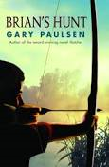





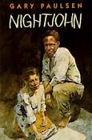

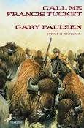




Murphy’s Gold
Sentries
The Night the White Dear Died
Tucket’s Home
Alida’s Song
Escape from Fire Mountain
Masters of Disaster
Paintings from the Cave
Lawn Boy Returns
Crossing
The White Fox
Flat Broke
Tucket’s Gold
Time Benders
The Glass Cafe
List of Books
Sarny
Harris and Me
Mudshark
The Car
Crush
The River
Soldier’s Heart
Guts
Canyons
Tracker
Dogteam
Tucket’s Ride
Liar Liar
Road Trip

Slide 6
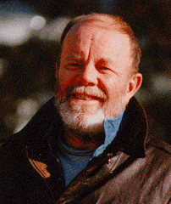
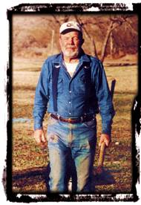
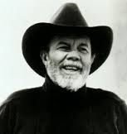
Gary Paulsen
Paulsen failed the ninth grade the first time, and only graduated with a D-average! But he is now very successful.
Three-time Newberry Honor Award winner for his books, he has the silver medallion on three of his books!
His wife, Ruth Wright Paulsen, had illustrated some of his books. She was able to draw the pictures that went in them!

Slide 7
Website to find author
http://www.randomhouse.com/features/garypaulsen/about.html
https://www.goodreads.com/author/show/18.Gary_Paulsen
http://www.ipl.org/div/askauthor/paulsen.html

